Slide 1





Introduction to Robotic Process Automation
Expense Report Generator
220701102
JAYANEE.J
Mrs. J. Jinu Sophia
Assistant Professor (SG)

Slide 2
Abstract
The Expense Report Generator is an automated solution that simplifies financial data management by extracting key details from receipt images using OCR and Regex. It identifies the date, vendor, amount, and categorizes expenses into predefined groups such as Food, Transportation, Clothing, Entertainment, and Electronics. The system organizes this data into a DataTable, exports it to Excel, and displays the total expense in a message box. Designed using UiPath, it reduces manual effort, improves accuracy, and provides a user-friendly, efficient way to track expenses, making it ideal for personal and organizational use.

Slide 3
Need for the Proposed System
Existing System Limitations:
Inaccuracy: Manual data entry leads to errors.
Slow: Time-consuming categorization and reporting.
High Costs: Dependence on manual labor.
Proposed System Advantages:
Automation: Reduces manual effort.
Accuracy: Error-free extraction with OCR/Regex.
Speed: Instant report generation.

Slide 4
Advantages of the Proposed System
Automation: Reduces manual entry, saving time and effort.
Accuracy: Ensures precise data extraction with OCR and Regex.
Efficiency: Quickly processes data and generates reports.
User-Friendly: Simple interface with instant expense total.
Customization: Easily adaptable for new categories or integrations.

Slide 5
Literature Survey
Title: "Automating Expense Management with OCR and AI"
Advantages:
Time Savings: Reduces manual work.
Accuracy: Minimizes human errors.
Cost-Efficient: Lowers labor costs and increases productivity.
Disadvantages:
Setup Costs: High initial implementation costs.
Image Quality Dependency: OCR accuracy depends on receipt image quality.
Categorization Challenges: Difficulties in categorizing ambiguous expenses.

Slide 6
Main Objective
The main objective of the Expense Report Generator is to automate the extraction, categorization, and reporting of financial data from receipt images, ensuring accuracy, efficiency, and seamless management of expenses with minimal manual intervention.

Slide 7
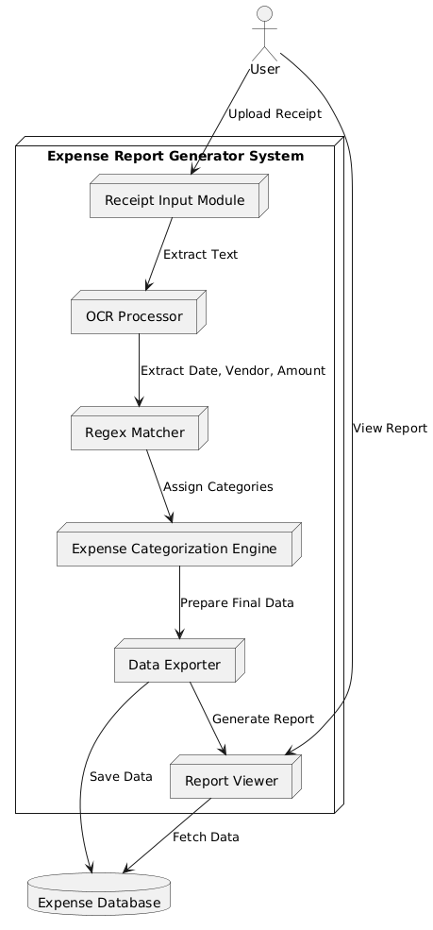
Architecture

Slide 8
System Requirements
Software:
UiPath Studio: For developing the automation workflow.
OCR Tool (Microsoft OCR/Tesseract): For extracting text from
receipt images.
Microsoft Excel: For exporting the expense report.
Hardware:
Processor: 2.0 GHz or higher dual-core (Intel i5 or equivalent).
RAM: 4GB minimum (8GB recommended).
Storage: 2GB free disk space for installation.

Slide 9
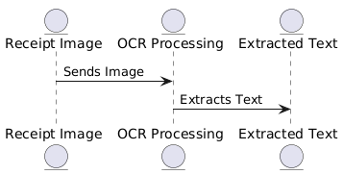
Functional Description
Module 1: Receipt Image Processing:
Extracts text from receipt images using OCR.

Slide 10
Functional Description
Module 2: Data Extraction and Categorization
Uses regex to extract key details and categorizes expenses

Slide 11
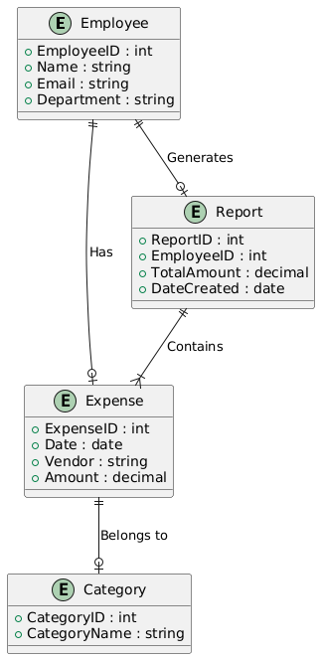
Table Design
ERD

Slide 12
Process Design
Main Process:
OCR Processing: Extracts text (vendor, amount, date) from receipt images.
Data Extraction: Uses Regex to extract key details (Date, Vendor, Amount).
Report Generation: Exports data to Excel to create an expense report.
Sub-processes:
Categorization: Classifies expenses (Food, Transport, etc.).
Total Calculation: Calculates and displays the total amount.

Slide 13
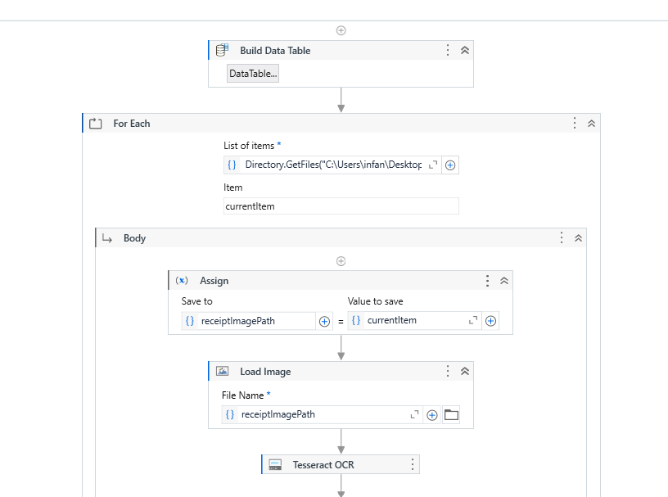
Implementation
Module 1: Receipt Image Processing:
Extracts text from receipt images using OCR.

Slide 14
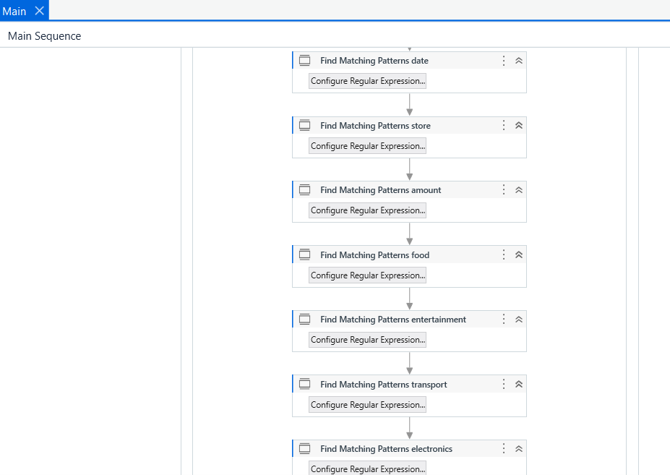
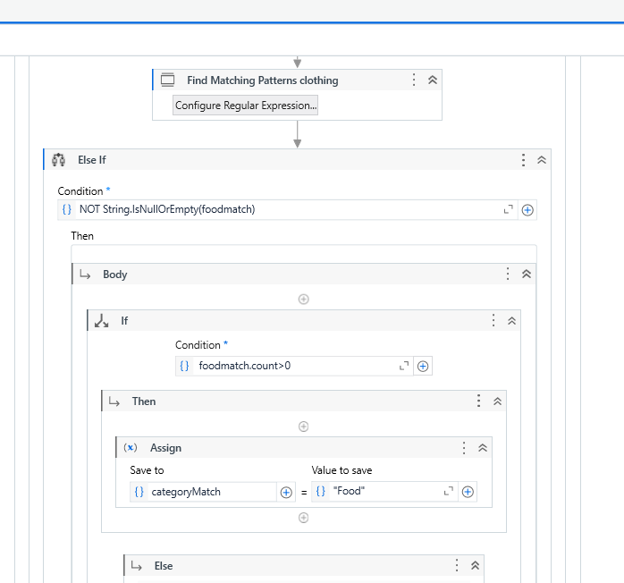
Implementation
Module 2: Data Extraction and Categorization
Uses regex to extract key details and categorizes expenses

Slide 15
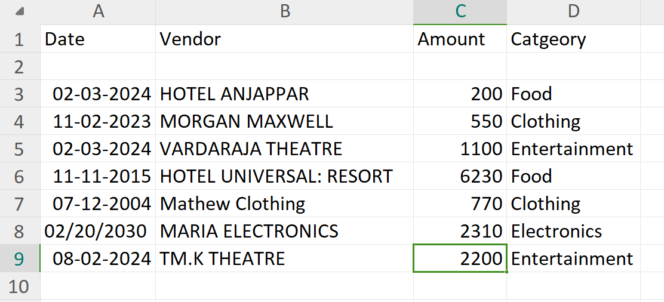
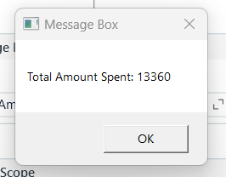
Testing
Testing ensures accurate data extraction, categorization, and report generation, along with performance, security, and usability for reliability and efficiency.

Slide 16
Conclusions
The Expense Report Generator automates receipt data extraction, categorization, and report generation, improving accuracy and efficiency while reducing manual effort and errors.

Slide 17
Future Enhancement
Multi-language Support: Enabling OCR to process receipts in different languages.
AI-powered Categorization: Using machine learning for smarter, auto-learning expense categorization.

Slide 18
IEEE Paper
Expense Tracking with Tesseract Optical Character Recognition v5: A Mobile Application Development
eExpense: A Smart Approach to Track Everyday Expense
OCR for Data Retrieval: An Analysis and Machine Learning Application Model for NGO Social Volunteering

Slide 19
References
"Expense Tracking with Tesseract Optical Character Recognition v5: A Mobile Application Development," IEEE Xplore, [Online]. Available: https://ieeexplore.ieee.org/document/9712345.
"eExpense: A Smart Approach to Track Everyday Expense," IEEE Xplore, [Online]. Available:https://ieeexplore.ieee.org/document/9374985.
A. Sharma, R. Gupta, and P. Agarwal, "OCR for Data Retrieval: An Analysis and Machine Learning Application Model for NGO Social Volunteering," IEEE Xplore, [Online]. Available: https://ieeexplore.ieee.org/document/9640890.

Slide 20
Thank You

